Slide 1
The Transport Layer
Chapter 6

Slide 2
Transport Service
Upper Layer Services
Transport Service Primitives
Berkeley Sockets
Example of Socket Programming:
Internet File Server

Slide 3
The Transport Layer
To allow users to access the transport service, the transport layer must provide some operations to application programs, that is, a transport service interface.

Slide 4
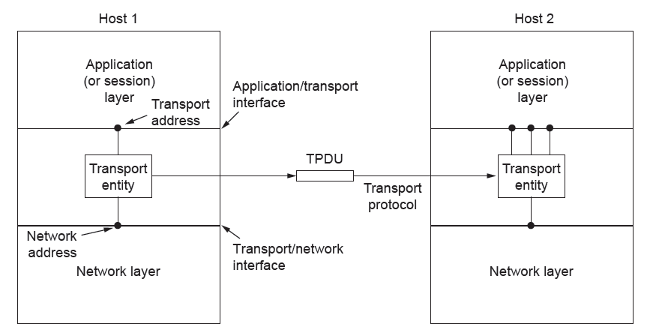
Services Provided to the Upper Layers
The network, transport, and application layers
Establishment, data transfer and release/ Make it more reliable than the underlying layer

Slide 5
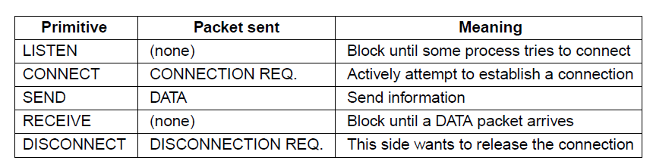
Transport Service Primitives (1)
The primitives for a simple transport service

Slide 6
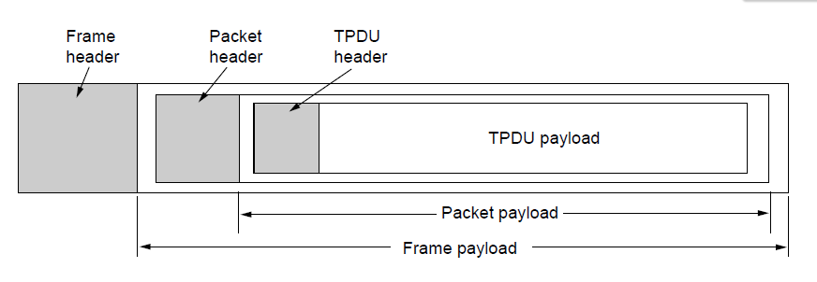
Transport Service Primitives (2)
Nesting of TPDU (Transport Protocol Data Unit) s, packets, and frames.

Slide 7
Elements of Transport Protocols (1)
Addressing
Connection establishment
Connection release
Error control and flow control
Multiplexing
Crash recovery

Slide 8
Similarity between data link and transport layer
Connection establishment
Connection release
Error control and flow control

Slide 9
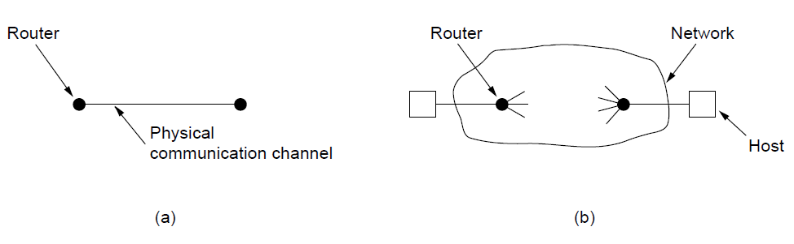
Elements of Transport Protocols (2)
Environment of the data link layer.
Environment of the transport layer.

Slide 10
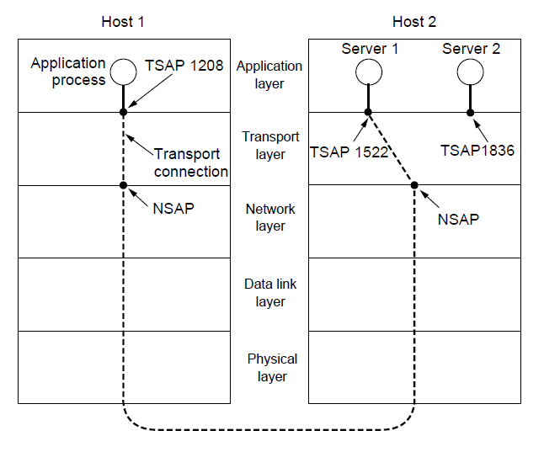
Addressing (1)
TSAPs, NSAPs, and transport connections

Slide 11
Addressing (2)
A possible scenario for a transport connection is as follows:
A mail server process attaches itself to TSAP 1522 on host 2 to wait for an incoming call. How a process attaches itself to a TSAP is outside the networking model and depends entirely on the local operating system. A call such as our LISTEN might be used, for example.
An application process on host 1 wants to send an email message, so it attaches itself to TSAP 1208 and issues a CONNECT request. The request specifies TSAP 1208 on host 1 as the source and TSAP 1522 on host 2 as the destination. This action ultimately results in a transport connection being established between the application process and the server.

Slide 12
Addressing (3)
3. The application process sends over the mail message.
4. The mail server responds to say that it will deliver the message.
5. The transport connection is released.

Slide 13
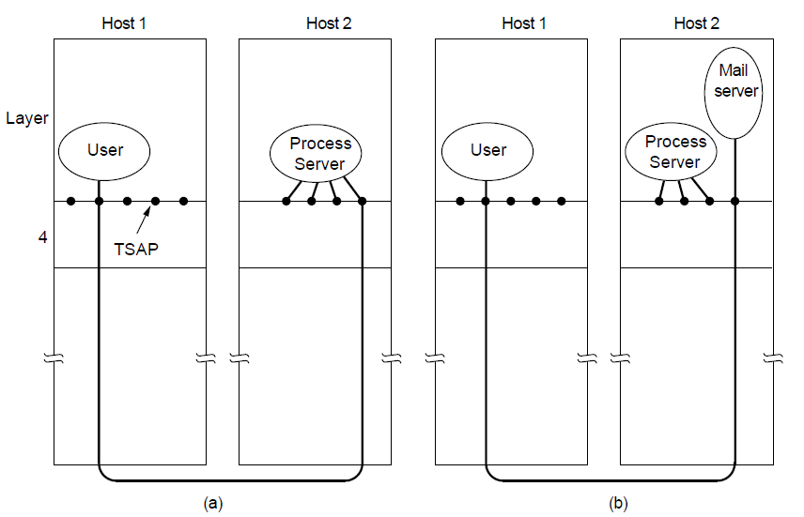
Addressing (4)
How a user process in host 1 establishes a connection
with a mail server in host 2 via a process server.

Slide 14
Connection Establishment (1)
Techniques for restricting packet lifetime
Throwaway transport addresses
Each connection a identifier <Peer transport entity, connection entity>

Slide 15
Connection Establishment (2)
Maintain history problem if crashed
Restricted network design.
Putting a hop counter in each packet.
Timestamping each packet.
Also acknowledgement needs to be erased with time T

Slide 16
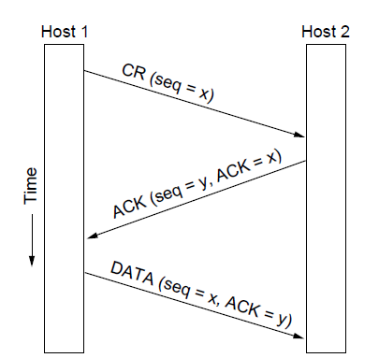
Connection Establishment (3)
Three protocol scenarios for establishing a connection using a
three-way handshake. CR denotes CONNECTION REQUEST. Normal operation.

Slide 17
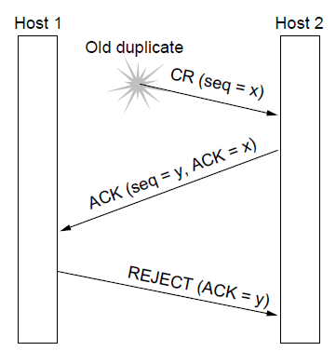
Connection Establishment (4)
Three protocol scenarios for establishing a connection using a
three-way handshake. CR denotes CONNECTION REQUEST. Old duplicate CONNECTION REQUEST appearing out of nowhere.

Slide 18
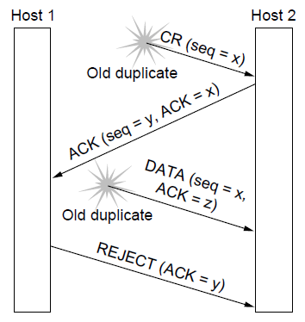
Connection Establishment (5)
Three protocol scenarios for establishing a connection using a
three-way handshake. CR denotes CONNECTION REQUEST. Duplicate CONNECTION REQUEST and duplicate ACK

Slide 19
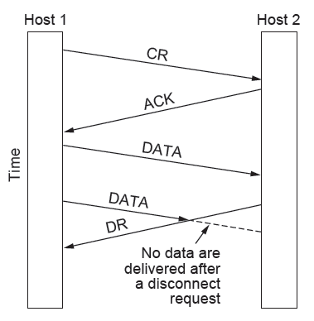
Connection Release (1)
Abrupt disconnection with loss of data – one way release or two way release

Slide 20
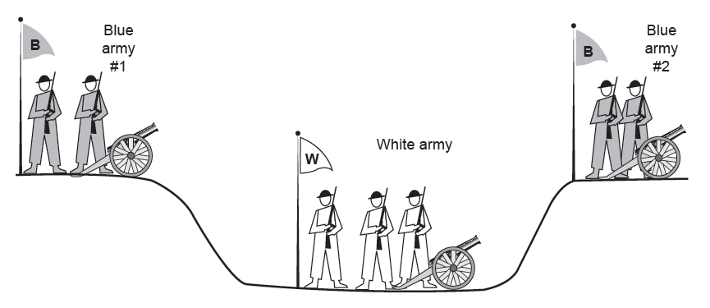
Connection Release (2)
The two-army problem
Synchronize which will go on infinitely

Slide 21
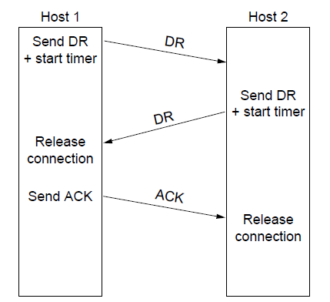
Connection Release (3)
Four protocol scenarios for releasing a connection.
(a) Normal case of three-way handshake

Slide 22
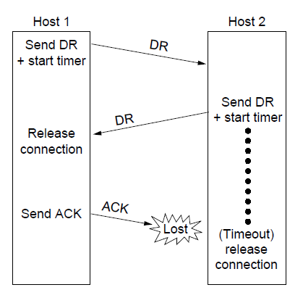
Connection Release (4)
Four protocol scenarios for releasing a connection.
(b) Final ACK lost.

Slide 23
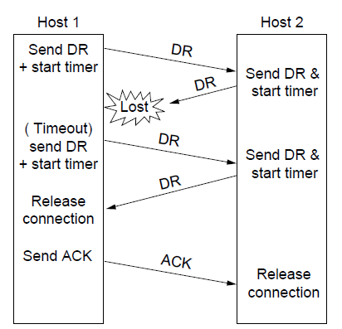
Connection Release (5)
Four protocol scenarios for releasing a connection.
(c) Response lost

Slide 24
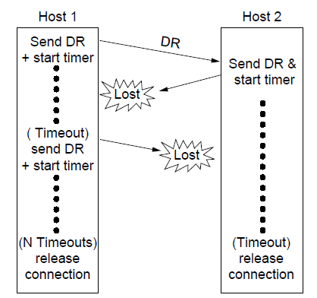
Connection Release (6)
Four protocol scenarios for releasing a connection.
(d) Response lost and subsequent DRs lost.

Slide 25
Error Control and Flow Control (1)
Error control is ensuring that the data is delivered with the desired level of reliability, usually that all of the data is delivered without any errors.
Flow control is keeping a fast transmitter from overrunning a slow receiver.

Slide 26
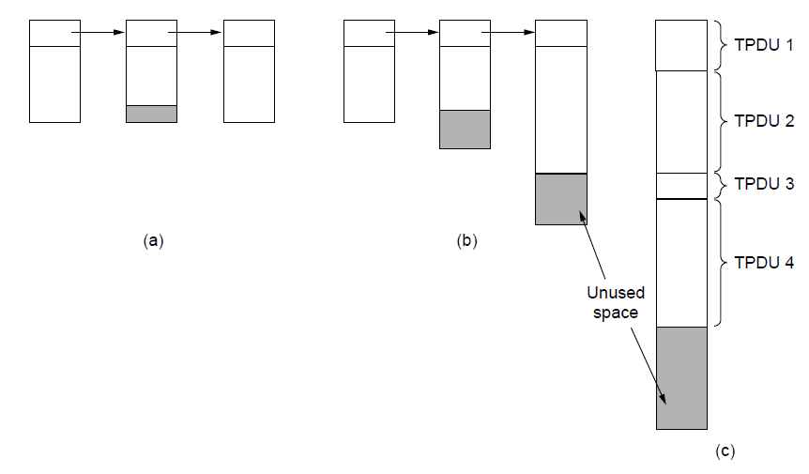
Error Control and Flow Control (2)
(a) Chained fixed-size buffers. (b) Chained variable-sized buffers. (c) One large circular buffer per connection.

Slide 27
Error Control and Flow Control (3)
As a very brief recap:
A frame carries an error-detecting code (e.g., a CRC or checksum) that is used to check if the information was correctly received.
A frame carries a sequence number to identify itself and is retransmitted by the sender until it receives an acknowledgement of successful receipt from the receiver. This is called ARQ (Automatic Repeat reQuest).
There is a maximum number of frames that the sender will allow to be outstanding at any time, pausing if the receiver is not acknowledging frames quickly enough. If this maximum is one packet the protocol is called stop-and-wait. Larger windows enable pipelining and improve performance on long, fast links.
The sliding window protocol combines these features and is also used to support bidirectional data transfer.

Slide 28
For low-bandwidth bursty traffic, it is better not allot buffer but dynamically allot buffer
Decouple sliding window protoco;

Slide 29
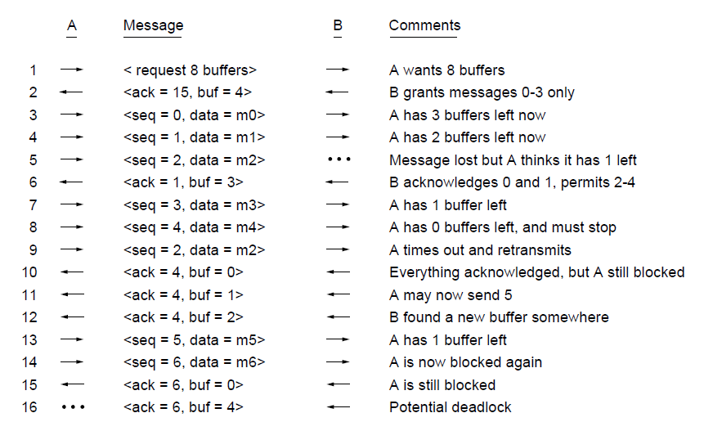
Error Control and Flow Control (2)
Dynamic buffer allocation. The arrows show the direction of transmission. An ellipsis (...) indicates a lost TPDU

Slide 30
Infinite size buffer – k disjoint paths, x packets/sec
there is no way that those hosts can exchange more than kx segments/sec, no matter how much buffer space is available at each end
If the network can handle c TPDU/sec, cycle time – r then total = cr (Sender window should be)

Slide 31
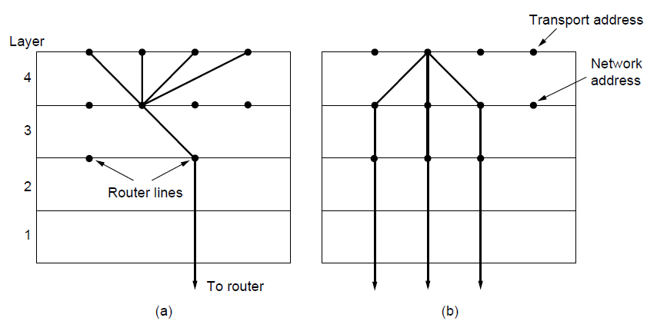
Multiplexing
(a) Multiplexing. (b) Inverse multiplexing.

Slide 32
Server side events
Three events are possible at the server:
sending an acknowledgement (A),
writing to the output process (W),
and crashing (C).
The three events can occur in six different orderings: AC(W), AWC, C(AW), C(WA), WAC, and WC(A), where the parentheses are used to indicate that neither A nor W can follow C (i.e., once it has crashed, it has crashed).

Slide 33
Client Side Events
The client can be programmed in one of four ways:
always retransmit the last segment,
never retransmit the last segment,
retransmit only in state S0,
retransmit only in state S1.
Each client can be in one of two states: one segment outstanding, S1, or no segments outstanding, S0

Slide 34
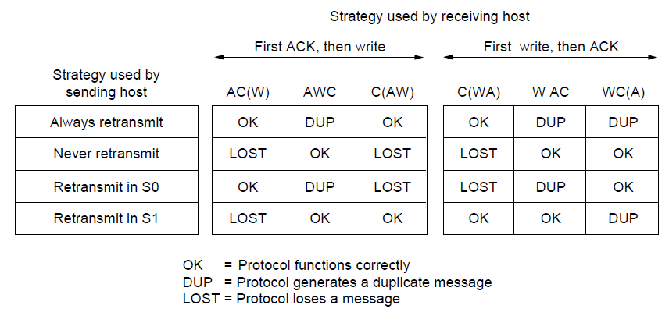
Crash Recovery
Different combinations of client and server strategy

Slide 35
The Internet Transport Protocols: TCP (1)
Introduction to TCP
The TCP service model
The TCP protocol
The TCP segment header
TCP connection establishment
TCP connection release

Slide 36
The Internet Transport Protocols: TCP (2)
TCP connection management modeling
TCP sliding window
TCP timer management
TCP congestion control
TCP futures

Slide 37
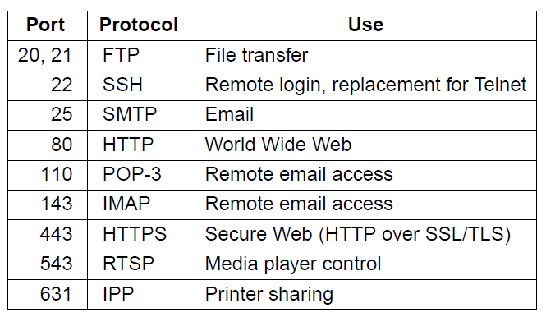
The TCP Service Model (1)
Some assigned ports
Internet Daemon (inetd) attach itself to multiple ports and wait for the first connection request, then fork to that service

Slide 38
All TCP connections are full duplex and point-to-point
Each connection has exactly two ends
TCP doesn’t support multicasting or broadcasting.

Slide 39
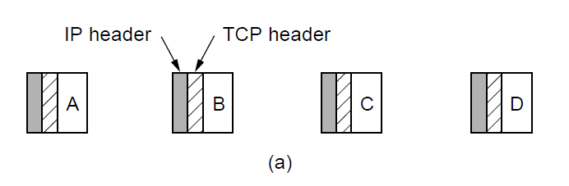
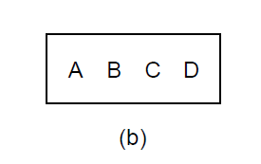
The TCP Service Model (2)
The TCP is byte-stream and not a message-stream, so messages are not differentiated.
Four 512-byte segments sent as separate IP diagrams
The 2048 bytes of data delivered to the application in a single READ call

Slide 40
The TCP Service Model (2)
To force data out -- PUSH flag
Too many PUSH-es then all PUSH are collected together and sent.
URGENT – on pushing Ctrl-C to break-off remote computation, the sending application puts some control flag

Slide 41
TCP Header
TCP segment – 20 byte IP header, 20 –byte TCP header, total 65,535 = 64 KB

Slide 42
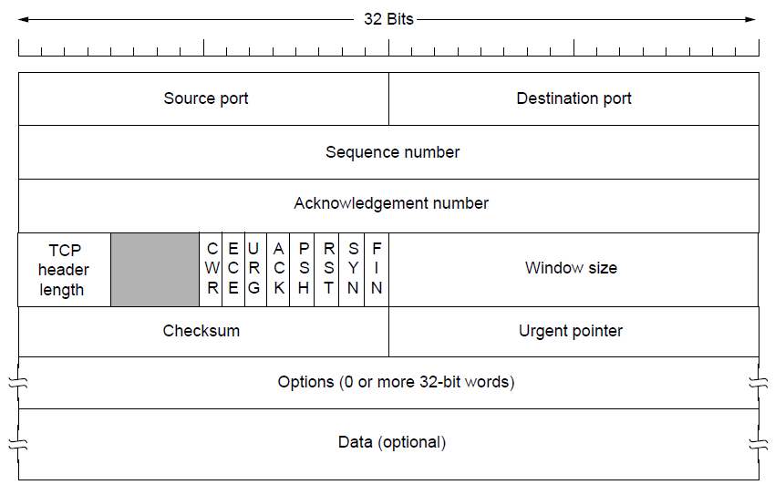
TCP Header

Slide 43
The TCP Segment Header
Ack no = one more – what is next expected
TCP Header – how many optional field
CWR/ECE – Congestion controlling bits (ECE – Echo, CWR – Congestion window reduced)
URG – Urgent, (URGENT POINTER – OFFSET) ACK – Acknowledgement, PSH – Pushed RST – reset, SYN = 1 (CONNECTION REQUEST, CONNECTION ACEEPTED), ACK =0 (REQUEST) ACK = 1(ACCEPT)
WINDOW SIZE = HOW MANY BUFFERS MAY BE GRANTED, CAN BE ZERO

Slide 44
The TCP Segment Header
CHECK SUM – IP ADDR + TCP HEADER + DATA,
ADD ALL THE 16 BITS WORD IN ONES COMPLEMENT AND THEN TAKE ONE’ COMPLEMENT OF THE SUM
ON ADD WITH CHECKSUM – SUMMATION WOULD BE ZERO
CROSS LAYER

Slide 45
The TCP Segment Header
INSTEAD OF GO-BACK-N, HAVE NAKS

Slide 46
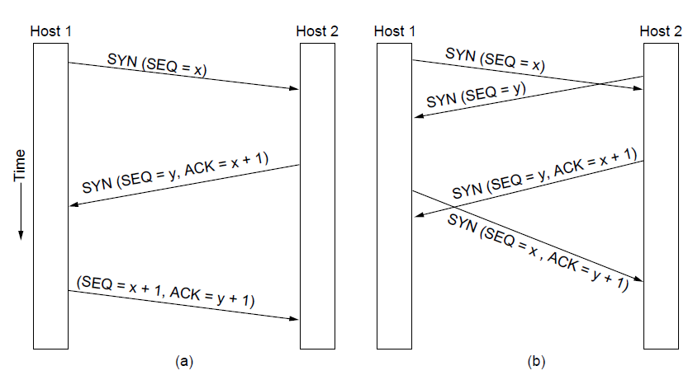
TCP Connection Establishment
TCP connection establishment in the normal case.
Simultaneous connection establishment on both sides.

Slide 47
TCP Connection Release
Either party send with the FIN bit set
When the FIN is acknowledged, that direction is shut down for new data
Full closing (TWO FIN and TWO ACK)

Slide 48
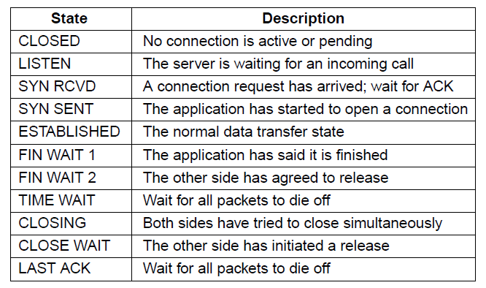
TCP Connection Management Modeling (1)
The states used in the TCP connection
management finite state machine.

Slide 49
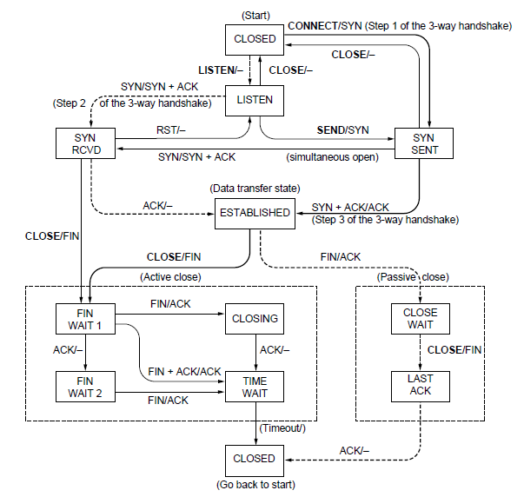
TCP Connection Management Modeling (2)
TCP connection management finite state machine.
The heavy solid line is the normal path for a client. The heavy dashed line is the normal path for a server. The light lines are unusual events. Each transition is labeled by the event causing it and the action resulting from it, separated by a slash.

Slide 50
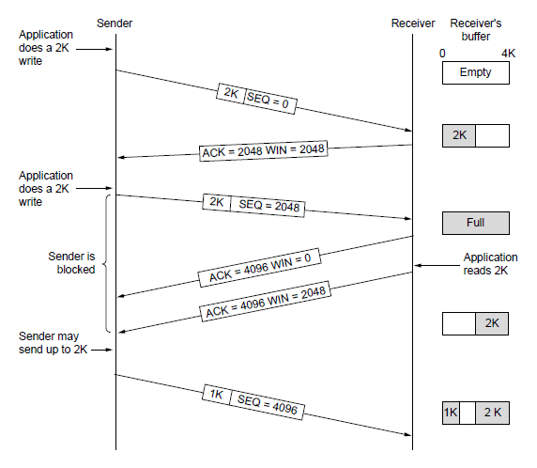
TCP Sliding Window (1)
Window management in TCP
When send – with ) window size – a). Urgent bytes and b). 1- byte to make the receiver to reannounce the next byte expected

Slide 51
When the window is 0, the sender may not normally send segments, with two exceptions.
First, urgent data may be sent, for example, to allow the user to kill the process running on the remote machine.
Second, the sender may send a 1-byte segment to force the receiver to reannounce the next byte expected and the window size. This packet is called a window probe.

Slide 52
Nagle’s Algorithm
Interactive Editor --- Sending 1-byte would involve 162 bytes (40 to send, 40 to ACK, 41 to update, 40 to ack)
Nagle’s Algorithm – When data comes into the sender one byte at a time, just send the first byte and buffer the rest until the outstanding byte is acknowledged

Slide 53
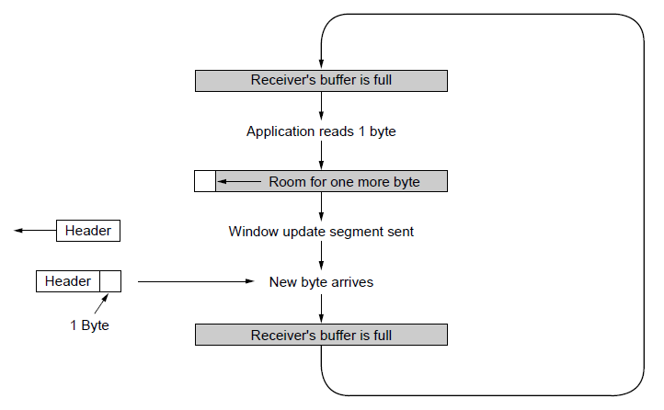
TCP Sliding Window (2)
Silly window syndrome … Clark’s solution – prevent receiver from sending a window update for 1 byte.
Specifically the receiver should not send a window update until it get the maximum segement advertised free

Slide 54
Initially, the TCP buffer on the receiving side is full (i.e., it has a window of size 0) and the sender knows this. Then the interactive application reads one character from the TCP stream.
This action makes the receiving TCP happy, so it sends a window update to the sender saying that it is all right to send 1 byte.
The sender obliges and sends 1 byte. The buffer is now full, so the receiver acknowledges the 1-byte segment and sets the window to 0.
This behavior can go on forever.
Clark’s solution is to prevent the receiver from sending a window update for 1 byte. Instead, it is forced to wait until it has a decent amount of space available and advertise that instead.

Slide 55
Nagle’s algorithm and Clark’s solution to the silly window syndrome are complementary.
Nagle was trying to solve the problem caused by the sending application delivering data to TCP a byte at a time.
Clark was trying to solve the problem of the receiving application sucking the data up from TCP a byte at a time.
The goal is for the sender not to send small segments and the receiver not to ask for them.

Slide 56
TCP Congestion Control
Transport protocol using an AIMD (Additive Increase Multiplicative Decrease) control law in response to binary congestion signals from the network would converge to a fair and efficient bandwidth allocation
Congestion window is maintained in addition to the flow control window, which specifies the number of bytes that the receiver can buffer.
Both windows are tracked in parallel, and the number of bytes that may be sent is the smaller of the two windows.

Slide 57
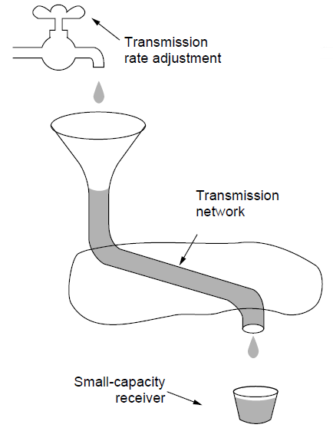
TCP Congestion Control -- Regulating the Sending Rate (1)
A fast network feeding a low-capacity receiver

Slide 58
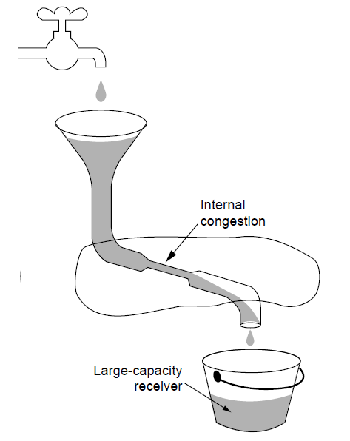
Regulating the Sending Rate (2)
A slow network feeding a high-capacity receiver

Slide 59
TCP Congestion Control
Two windows – the window a receiver window grants
Congestion window
Slow start – 1024 byte - move exponentially – SLOW START
Set threshold – grow linearly after that

Slide 60
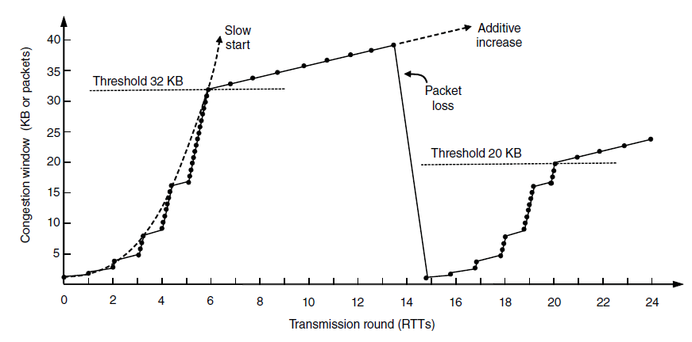
TCP Congestion Control (3)
Slow start followed by additive increase in TCP Tahoe.

Slide 61
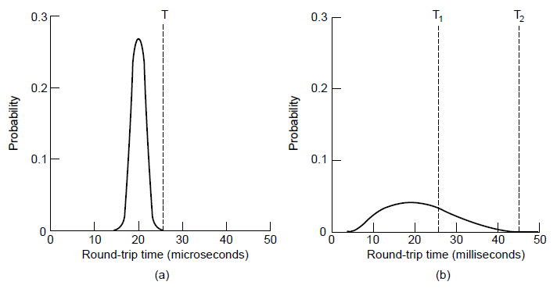
TCP Timer Management
(a). Retransmission timer
Probability density of acknowledgment arrival times in data link layer. (b) … for TCP

Slide 62
For each connection, TCP maintains a variable, SRTT (Smoothed Round-Trip Time), that is the best current estimate of the round-trip time to the destination in question.
The acknowledgement gets back before the timer expires, TCP measures how long the acknowledgement took, say, R. It then updates SRTT according to the formula
SRTT =αSRTT + (1 −α ) R
where α is a smoothing factor that determines how quickly the old values are forgotten. Typically, α=7/8. This kind of formula is an EWMA (Exponentially Weighted Moving Average) or low-pass filter that discards noise in the samples.

Slide 63
Retransmission Timer
RTTVAR (RoundTrip Time VARiation) that is updated using the formula
RTTVAR =βRTTVAR + (1 −β)|SRTT − R |
This is an EWMA as before, and typically β=3/4.
The retransmission timeout, RTO, is set to be
RTO = SRTT + 4 × RTTVAR

Slide 64
Retransmission Timer
Karn’s algorithm – In dynamic estimation of RTT when a segment times out and is resend.
It is not clear whether the acknowledgement is from the original or resend.
SO don’t include resend packets RTT into calculation.
Each time failure double Time-out time

Slide 65
Persistence Timer
When Persistence timer goes off the transmitter pings the receiver whether buffer space is available
Keepalive TImer
If idle → checks whether the connection is active and then if not closes connection
CONTROVERSIAL – It may stop healthy connection due to transient network partitioning

Slide 66
The Internet Transport Protocols: UDP
Introduction to UDP
Remote Procedure Call
Real-Time Transport

Slide 67
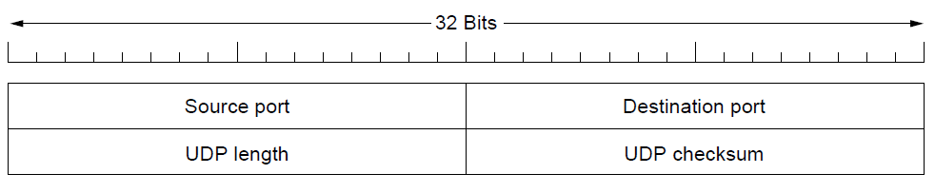
Introduction to UDP (1)
The UDP header.
Checksum not used (digitized speech)
Does not flow-control, error control or timing
Does Multiplexing
UDP useful – client-server situations, client sends a short request to the server and expects a short reply back. If time-out retransmit rather than establish connection
Use-case – host name to a DNS server

Slide 68
Introduction to UDP (2)
The source port is primarily needed when a reply must be sent back to the source. By copying the Source port field from the incoming segment into the Destination port field of the outgoing segment.
The UDP length field includes the 8-byte header and the data. The minimum length is 8 bytes, to cover the header. The maximum length is 65,515 bytes.
It checksums the header, the data, and a conceptual IP pseudoheader. When performing this computation, the Checksum field is set to zero and the data field is padded out with an additional zero byte if its length is an odd number

Slide 69
Remote Procedure Call
get_ip_address(host_name)

Slide 70
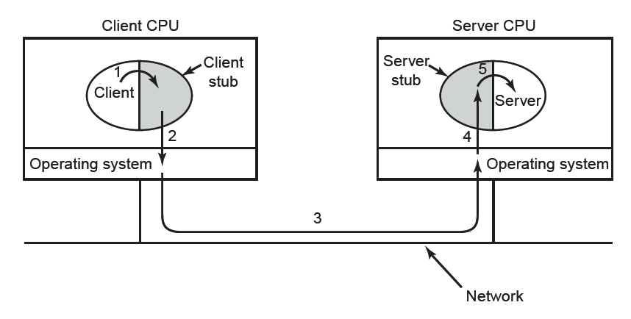
Remote Procedure Call
Steps in making a remote procedure call. The stubs are shaded.
Packing the parameters is called marshalling

Slide 71
Remote Procedure Call
get_ip_address(host_name)
Pointer, global variable

Slide 72
Real-Time Transport (1)
As Internet radio, Internet telephony,music-on-demand, videoconferencing, video-on-demand, and other multimedia applications became more commonplace, people have discovered that each application was reinventing more or less the same real-time transport protocol.
The first is the RTP protocol for transporting audio and video data in packets.
The second is the processing that takes place, mostly at the receiver, to play out the audio and video at the right time.

Slide 73
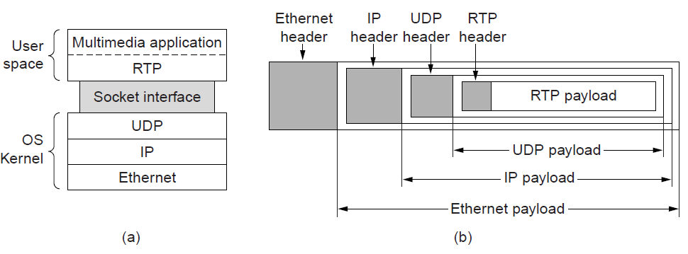
Real-Time Transport (2)
(a) The position of RTP in the protocol stack. (b) Packet nesting.

Slide 74
Real-Time Transport (3)
It is difficult to say which layer RTP is in
It is generic and application independent
Best Description - transport protocol implemented in the application layer
Basic Function of RTP – multiplex several real-time data streams onto a single stream of UDP packets.
Each packet is given a number one higher than its predecessor.
Allows the destination to determine whether any packets are missing
Then interpolate

Slide 75
Real-Time Transport (4)
Timestamp
Relative values can be obtained
Allow multiple streams (audio/video) to combine together

Slide 76
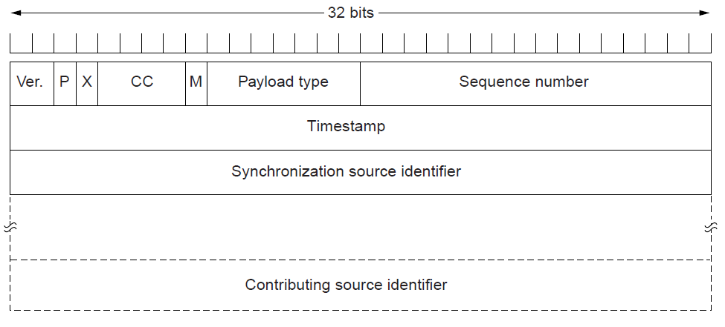
Real-Time Transport (5)
The RTP header

Slide 77
Real-Time Transport (6)
It consists of three 32-bit words and potentially some extensions. The first word contains the Version field, which is already at 2.
The P bit indicates that the packet has been padded to a multiple of 4 bytes.
The X bit indicates that an extension header is present. The format and meaning of the extension header are not defined.
The CC field tells how many contributing sources are present, from 0 to 15
The M bit is an application-specific marker bit. It can be used to mark the start of a video frame, the start of a word in an audio channel, or something else that the application understands

Slide 78
Real-Time Transport (7)
The Payload type field tells which encoding algorithm has been used (e.g., uncompressed 8-bit audio, MP3, etc.).
The Sequence number is just a counter that is incremented on each RTP packet sent. It is used to detect lost packets.
The Timestamp is produced by the stream’s source to note when the first sample in the packet was made.
Synchronization source identifier tells which stream the packet belongs to. It is the method used to multiplex and demultiplex multiple data streams onto a single stream of UDP packets.
Contributing source identifiers, if any, are used when mixers are present in the studio

Slide 79
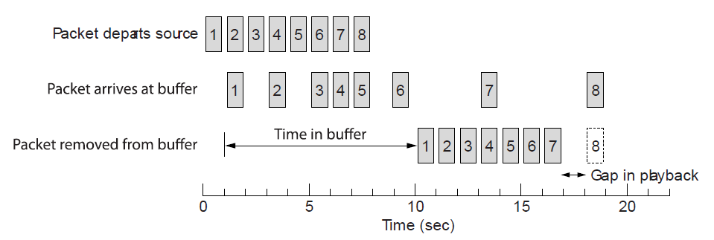
Real-Time Transport (8)
Smoothing the output stream by buffering packets

Slide 80
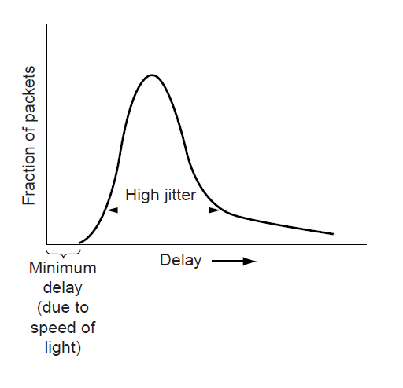
Real-Time Transport (9)
High jitter

Slide 81
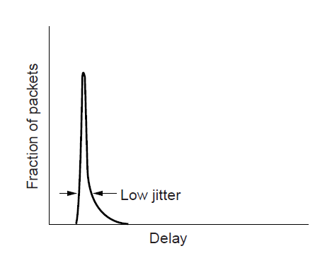
Real-Time Transport (10)
Low jitter

Slide 82
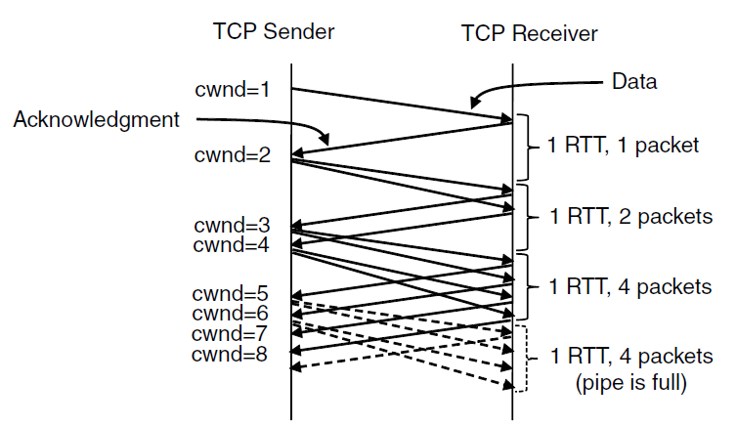
TCP Congestion Control (1)
Slow start from an initial congestion window of 1 segment

Slide 83
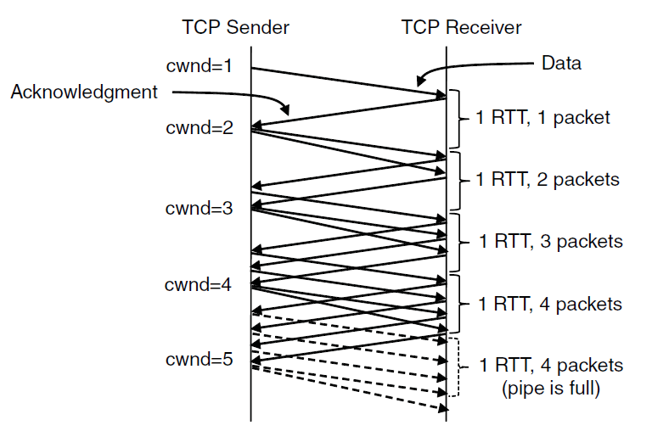
TCP Congestion Control (2)
Additive increase from an initial congestion
window of 1 segment.

Slide 84
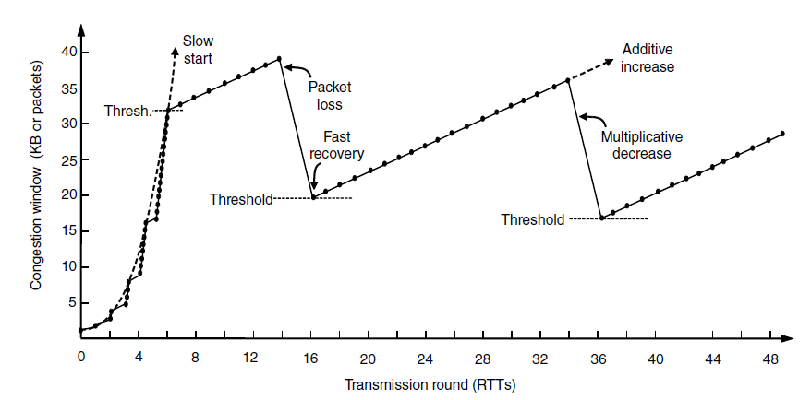
TCP Congestion Control (4)
Fast recovery and the sawtooth pattern of TCP Reno.

Slide 85
Performance Issues
Performance problems in computer networks
Network performance measurement
System design for better performance
Fast TPDU processing
Protocols for high-speed networks

Slide 86
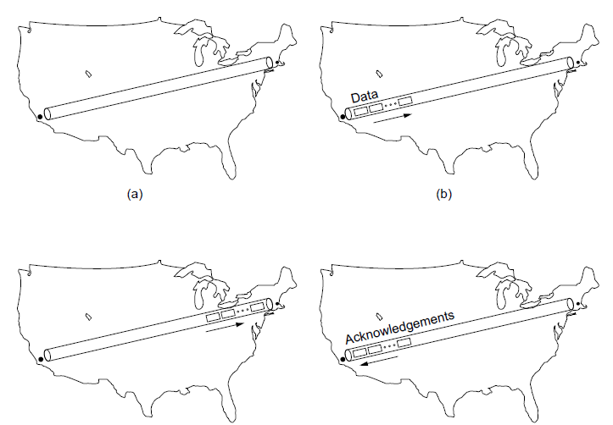
Performance Problems in Computer Networks
The state of transmitting one megabit from San Diego to Boston. (a) At t = 0. (b) After 500 μ sec.
(c) After 20 msec. (d) After 40 msec.

Slide 87
Network Performance Measurement (1)
Steps to performance improvement
Measure relevant network parameters, performance.
Try to understand what is going on.
Change one parameter.

Slide 88
Network Performance Measurement (2)
Issues in measuring performance
Sufficient sample size
Representative samples
Clock accuracy
Measuring typical representative load
Beware of caching
Understand what you are measuring
Extrapolate with care

Slide 89
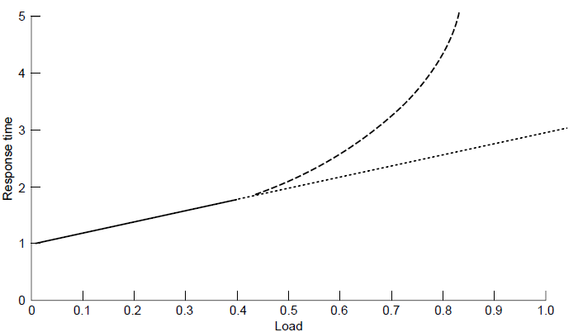
Network Performance Measurement (3)
Response as a function of load.

Slide 90
System Design for Better Performance (1)
Rules of thumb
CPU speed more important than network speed
Reduce packet count to reduce software overhead
Minimize data touching
Minimize context switches
Minimize copying
You can buy more bandwidth but not lower delay
Avoiding congestion is better than recovering from it
Avoid timeouts

Slide 91
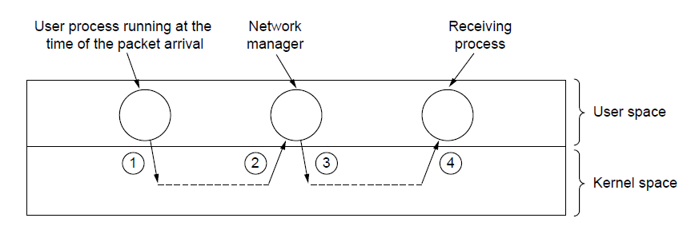
System Design for Better Performance (2)
Four context switches to handle one packet
with a user-space network manager.

Slide 92
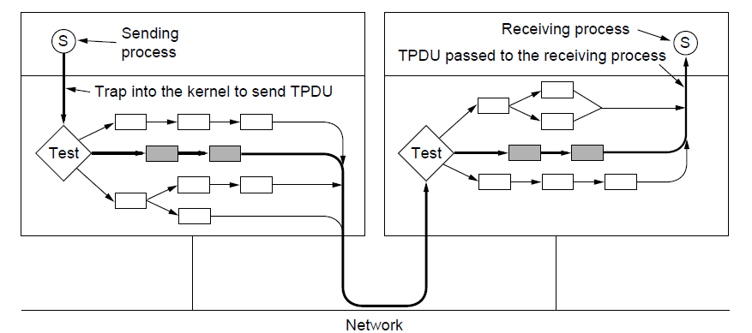
Fast TPDU Processing (1)
The fast path from sender to receiver is shown with a heavy line. The processing steps on this path are shaded.

Slide 93
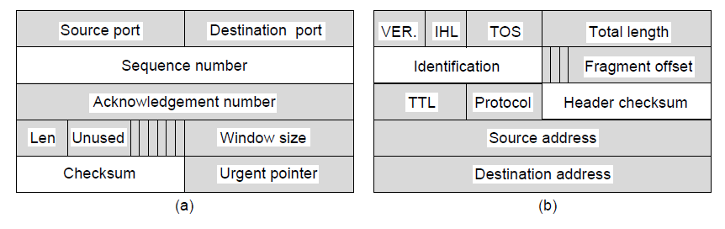
Fast TPDU Processing (2)
(a) TCP header. (b) IP header. In both cases, the shaded fields are taken from the prototype without change.

Slide 94
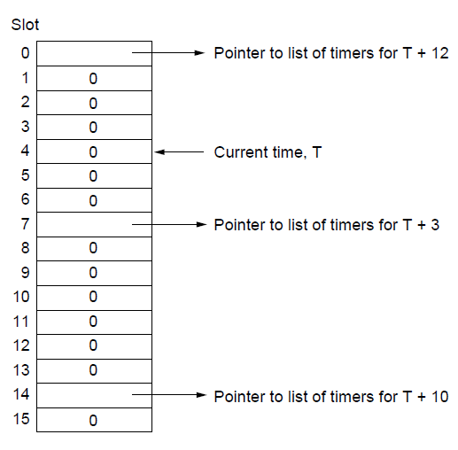
Protocols for High-Speed Networks (1)
A timing wheel

Slide 95
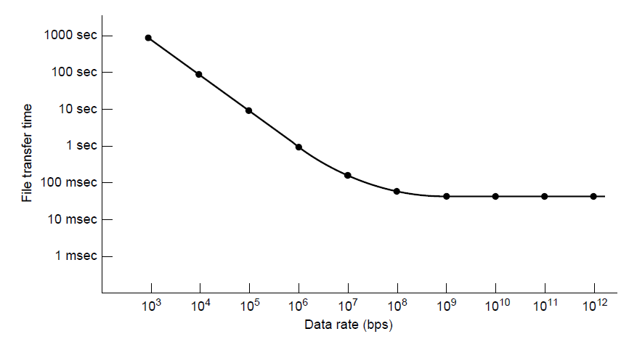
Protocols for High-Speed Networks (2)
Time to transfer and acknowledge a
1-megabit file over a 4000-km line

Slide 96
Delay Tolerant Networking
DTN Architecture
The Bundle Protocol

Slide 97
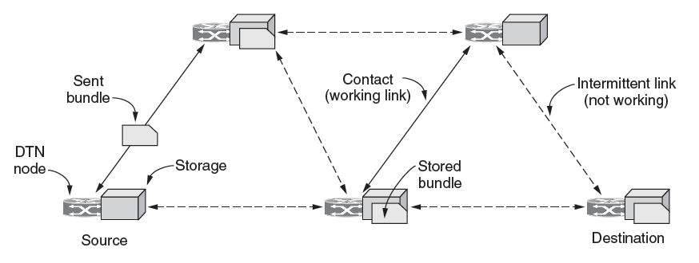
DTN Architecture (1)
Delay-tolerant networking architecture

Slide 98

DTN Architecture (2)
Use of a DTN in space.

Slide 99

The Bundle Protocol (1)
Delay-tolerant networking protocol stack.

Slide 100

The Bundle Protocol (2)
Bundle protocol message format.

Slide 101
Congestion Control
Desirable bandwidth allocation
Regulating the sending rate

Slide 102

Desirable Bandwidth Allocation (1)
(a) Goodput and (b) delay as a function of offered load

Slide 103

Desirable Bandwidth Allocation (2)
Max-min bandwidth allocation for four flows

Slide 104

Desirable Bandwidth Allocation (3)
Changing bandwidth allocation over time

Slide 105

Regulating the Sending Rate (3)
Some congestion control protocols

Slide 106

Regulating the Sending Rate (4)
User 2’s allocation
User 1’s allocation
Additive Increase Multiplicative Decrease (AIMD) control law.

Slide 107
End
Chapter 6

